Slide 1
SPACE SHOOTING
Intern: Nguyen Viet Phuong

Slide 2
CONTENT
About the game
Tools, language were used
Game testing
Future developments

Slide 3
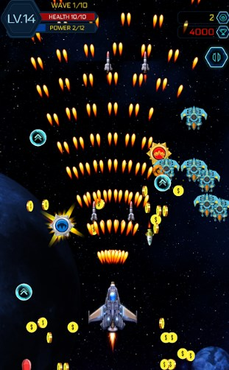
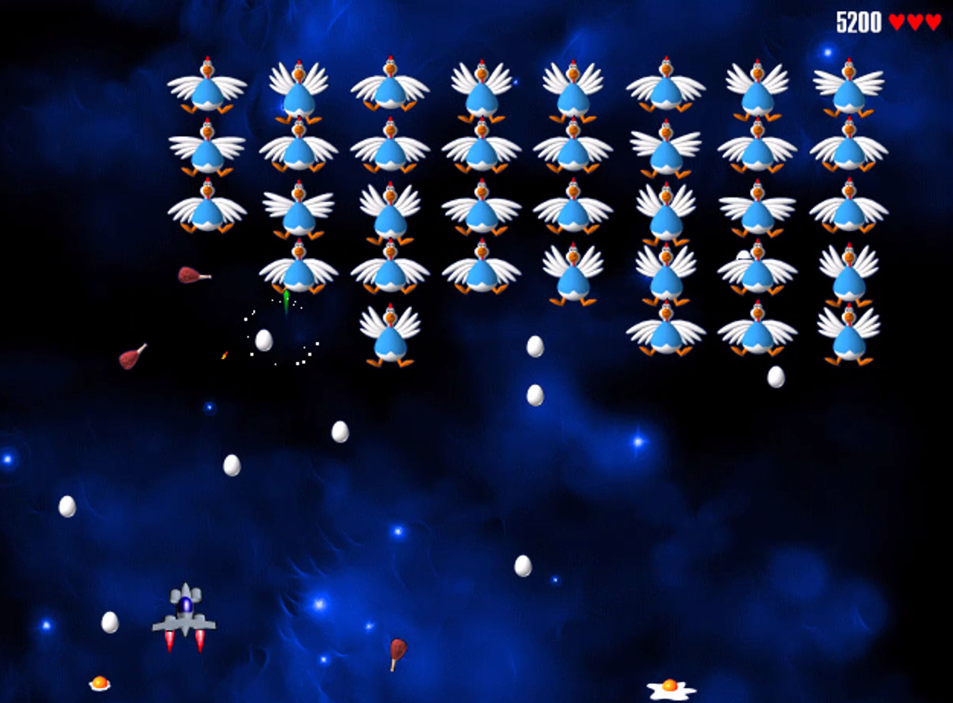
Ideal
Base on Space Shooter, Chicken Invaders, …
Can play on pc.
Chicken Invaders
Space Shooter

Slide 4
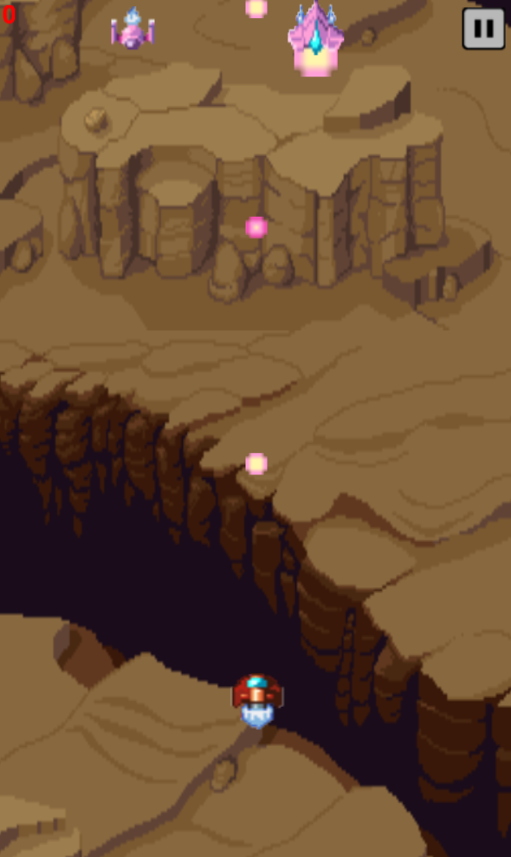
Game feature
Using keyboard to dodge enemy ships and bullet.
Auto-shooting to blast enemy ships and gain score.
Take power-up or heal to survive.

Slide 5

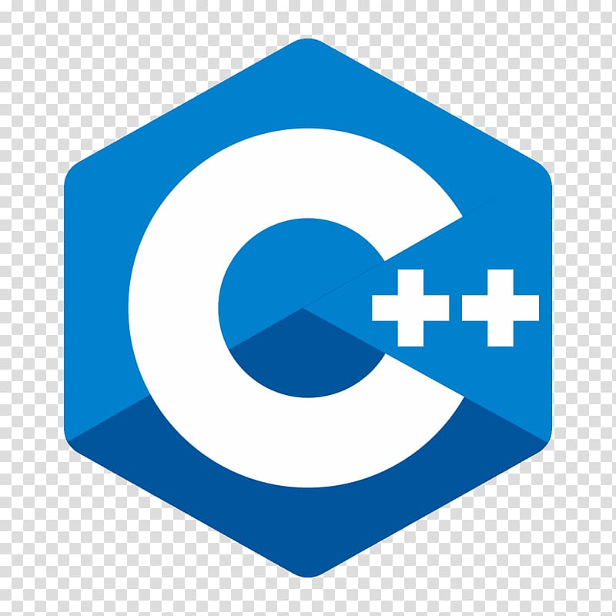


Tools and language
Tools:
Visual Studio Express 2015
Paint.NET
GitHub
Language: C++

Slide 6


Tools and language
Website for textures, sounds:
freepik, itch.io, …
Playonloop, orangefreesound, …

Slide 7
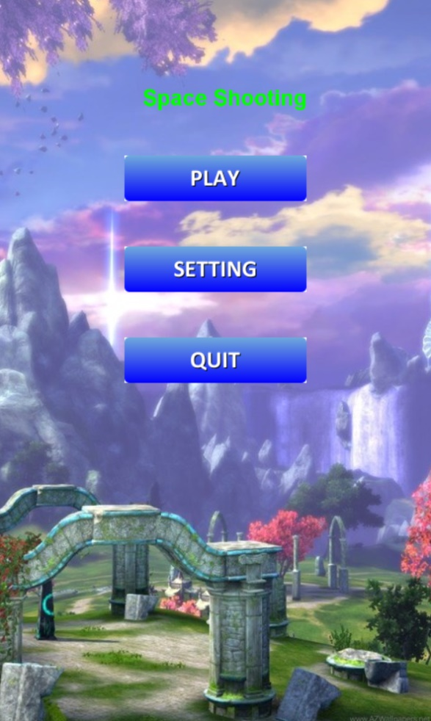
Game testing
Menu screen
Playing screen

Slide 8
Future developments
Ideal:
Add more kinds of bullet, power-up
Add more enemies’s move
Improve GUI
Optimize code more
Fix bug

Slide 9


